Slide 1
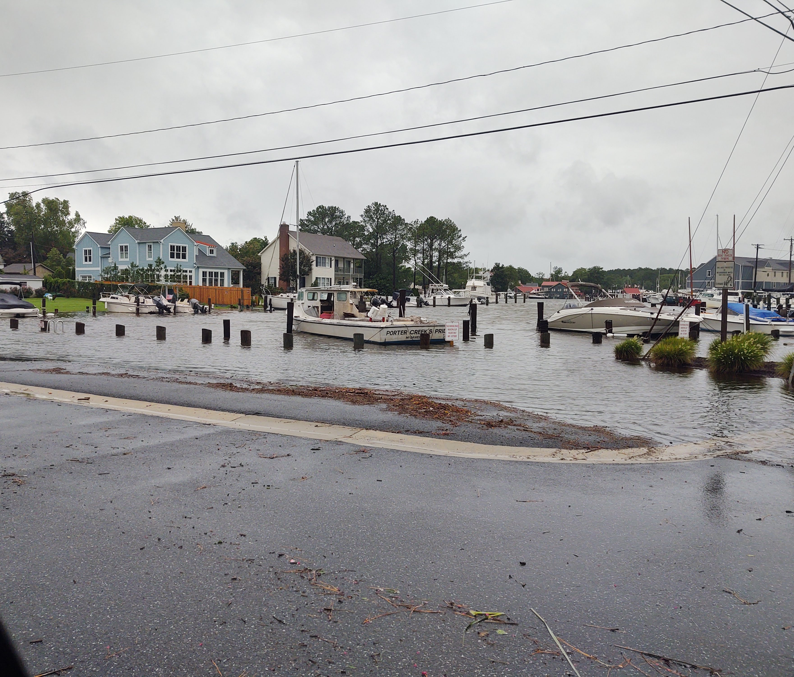
West Harbor Rd/ East Chew Public Slip Area Flood Mitigation
Mitigate flooding in the study area.
Improve area for all users.
Assess protections and green techniques.
Provide conceptual plans for future grant funding.
Brent Jett, P.E., CFM, CC-P Coastal Resiliency Group Leader, Senior Project Engineer with GMB, Seaford office.

Slide 2
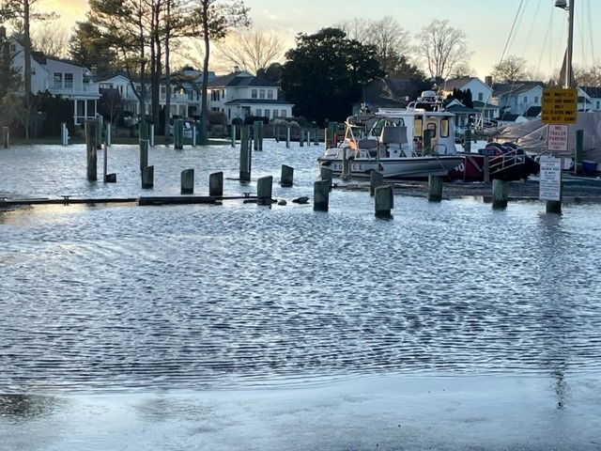
December 2022

Slide 3
Public Meeting Objectives:
Review options at the Public Slip Area around West Harbor Rd and East Chew
Bulkhead options
Pedestrian Improvements
Parking Layout & Finishes
Stormwater Handling

Slide 4
Previous Meeting Outcomes:
Pedestrian Safety, and a place for them to walk, was a frequent comment.
Lighting in the area is insufficient. We are proposing pole lighting similar to Muskrat Park along the waters edge.
Small boat ramp is underutilized. Option to install a family friendly kayak launch for more use, but still a dividing line.
Parking should remain, but the northern area utilized by watermen should have all watermen together, and delineated as “watermen only” slips and parking
The corner by waters edge is frequented by picture takers: a proposed park for this corner is suggested.
Stormwater is driving localized flooding.

Slide 5
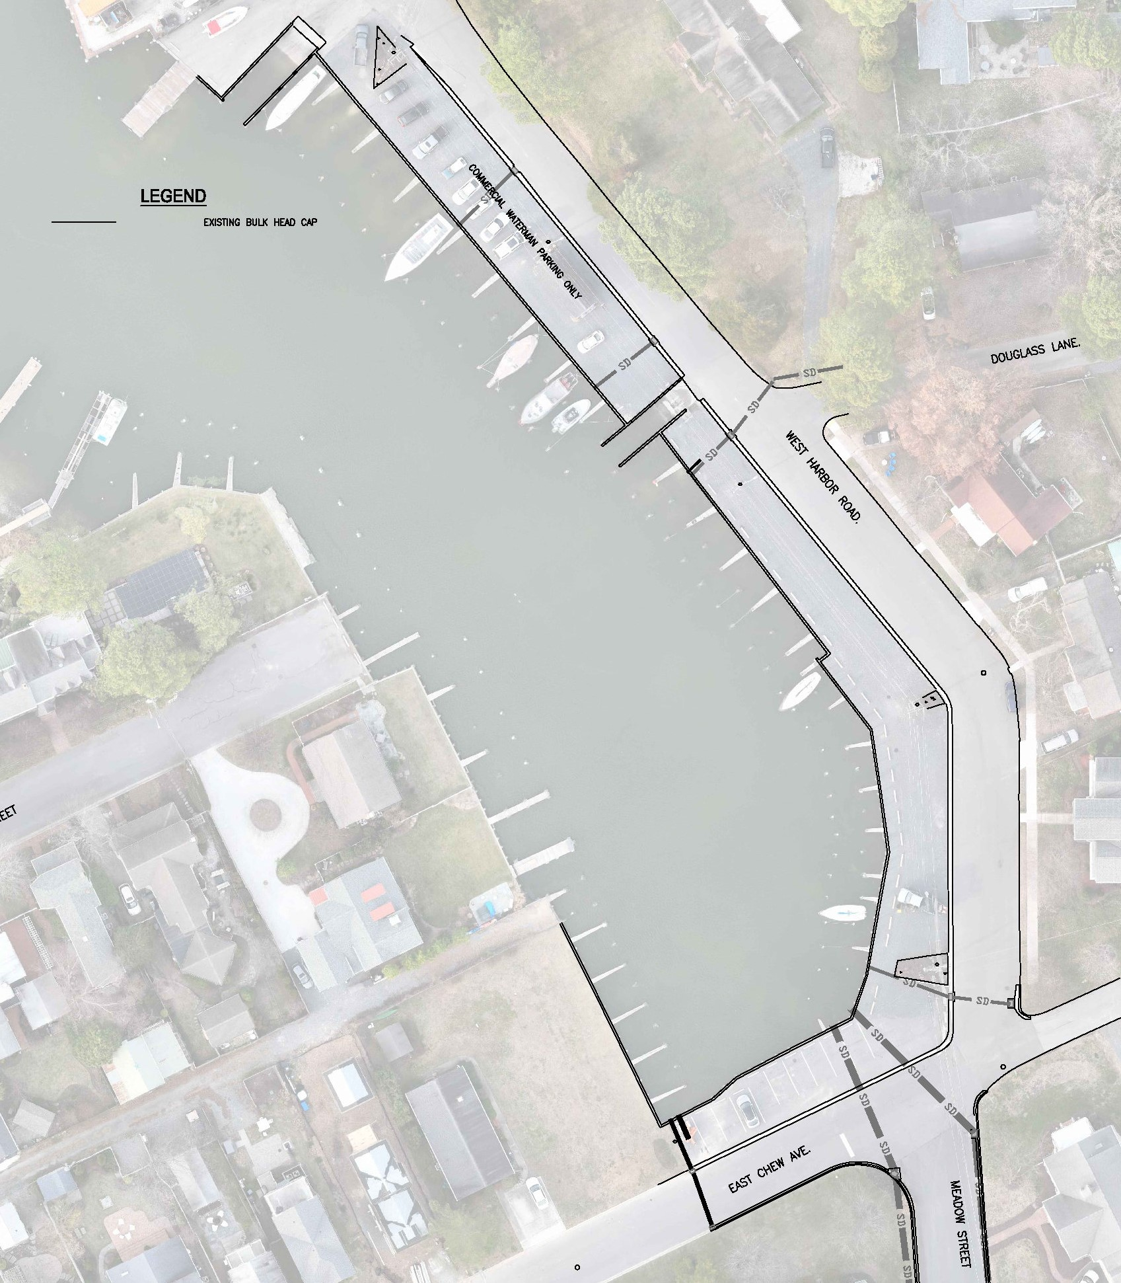
Existing Conditions

Slide 6
Existing Conditions:
Bulkhead at approx. el. 3.0’
48 parking spaces (not including potential w shed)
Possible to reduce parking to add green space
Hardpacked parking surface…not pervious.
Lots of grey-scape
No pedestrian paths
Lighting is intense in some areas, dull in others

Slide 7
Options Not Selected:
Keeping bulkhead at el. 3.0’, and adding another higher bulkhead behind it.
Installation is problematic, and you have TWO bulkheads to maintain.
Elevating bulkhead to el. 4.0’.
Minimal protection in the future with SLR.
Elevating bulkhead to el. 5.0’ and maintaining the remaining areas as-is.
No pedestrian paths, no green space, no true improvements.

Slide 8
-No structural remediation
-Green approach
-Does require maintenance on planted berm
-Shortens Parking spaces
-No increase in bulkhead height
-Grass berm to a boardwalk
-Parking to the boardwalk

Slide 9
Option A
New bulkhead back to current elevation at approx. el. 3.0’.
Grassed/planted berm at 3:1 slope up to el. 5.0’.
5’ wide walkway at top, el. 5.0’
Small retaining wall behind to transition to parking (14-18” high)
Reduction in parking to 40 total spaces.
Removal of shed to improve parking and continuity on watermen side of small boat ramp.

Slide 10
-Green approach with the berm which softens tidal impacts, and still provides walkway
-Requires maintenance on planted area, potential for erosion
-Options for various light installation…pedestals or antique style lights
-Steps across berm for access to piers from the walkway (think golf course steps)

Slide 11
Option B
New bulkhead in same location increased to el. 5.0’.
5’ wide walkway at back of new bulkhead, el. 5.0’
Grassed/planted area below the walkway at head of spaces, and increased green space between parking
Small retaining wall to transition to parking (14-18” high)
Reduction in parking to 40 total spaces.
Removal of shed to improve parking and continuity on watermen side of small boat ramp.

Slide 12
-Increased flood mitigation to el. 5.0’ without worry of washout or damage
-Planted areas behind could require high maintenance
-Options for various light installation…pedestals or antique style lights
-Steps to walkway at various spots from parking, with ramp from handicap spaces

Slide 13
-There will be a small elevation change/wall from the elevated walkway and the parking. For the watermen, they can back up to the walkway and have a minimal elevation change from walk to tailgate.
-In the public parking area, steps (2 or 3) will be needed to access the walkway from the parking. These can be in wood to match the walkway, or composite material.

Slide 14
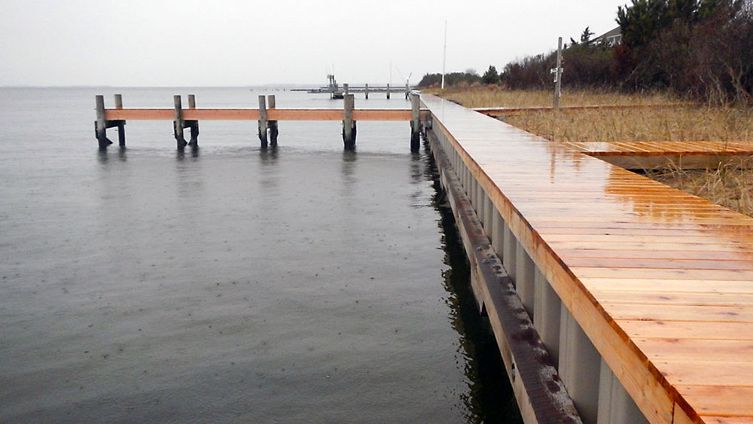
Wooden Walkway Behind Bulkhead

Slide 15
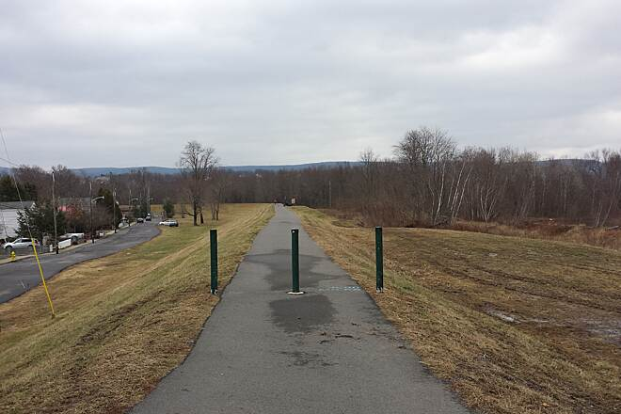
Grassed Berm Protection w Walkway on Top

Slide 16
Berm (A) vs Raised Bulkhead (B):
Same:
Top protection to el. 5.0’
Pedestrian paths
Green space
Improved lighting for area
Pervious Parking
Tide gates on all swm discharges
Dedicated spots for watermen
Different:
Green space affected by tide and surges vs bulkhead protection.
Pedestrian path against water/buffered from vehicles vs away from the water.
Potential for erosion on the berm and for it to collect trash

Slide 17
Green Space: Existing: +/- 20,000 sf…0 green
Option A:
Parking (pervious) 9,936sf
Walkway 3,145sf
Green Space/planted 7,214
36% green
Option B:
Parking (pervious) 11,112sf
Walkway 3,270sf
Green Space/planted 5,618
28% green

Slide 18
Other Improvements:
Removal of majority of parking along E. Chew for a new park area. Bricks/greenspace/benches?
This park will rest on top of the new stormwater cistern for the pump station. (Drainage from High School down Meadow St and adjacent areas as well as form Chew.)
New tide gates installed on all discharges to the open water to prevent tidal intrusion onto private property.
Removal of the storage shed.
Dedicated watermen-only slips grouped together.
Small boat ramp converted to kayak launch.

Slide 19
Parking Surface Options?
Installing the a pervious surface will lessen the runoff burden on the stormwater system, lessen the flooding potential, and help with any overtopping of the bulkhead in the future.
Suggestions:
Porous pavement for Watermen side parking.
Pavers (to match Muskrat Park and new sidewalks) for the remaining spaces.

Slide 20
Walking Path Surface Options?
Suggestions:
Wood planking for sections along W Harbor Rd.
Common application
Easy to manipulate elevations
Pervious
Brick Pavers (to match Muskrat Park and new sidewalks) for the Park area along E Chew.
More expensive
Consistent fit and finish throughout Town
Could be pervious or impervious

Slide 21
Other Surface Options?
Stone filled geogrid
Stones migrate and become a headache
Not very finished feeling or looking
Porous cement
Expensive
Difficult to replace small sections

Slide 22
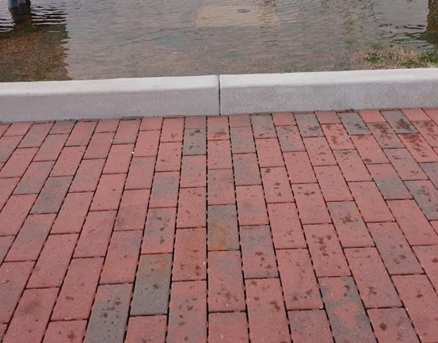
Pervious pavers
-Engineered pervious paver system
-Infiltrates stormwater to subsurface
-Infiltrates anything dumped on it as well
-Pervious design
-Many colorway options
-Matches other applications in St. Michaels already

Slide 23
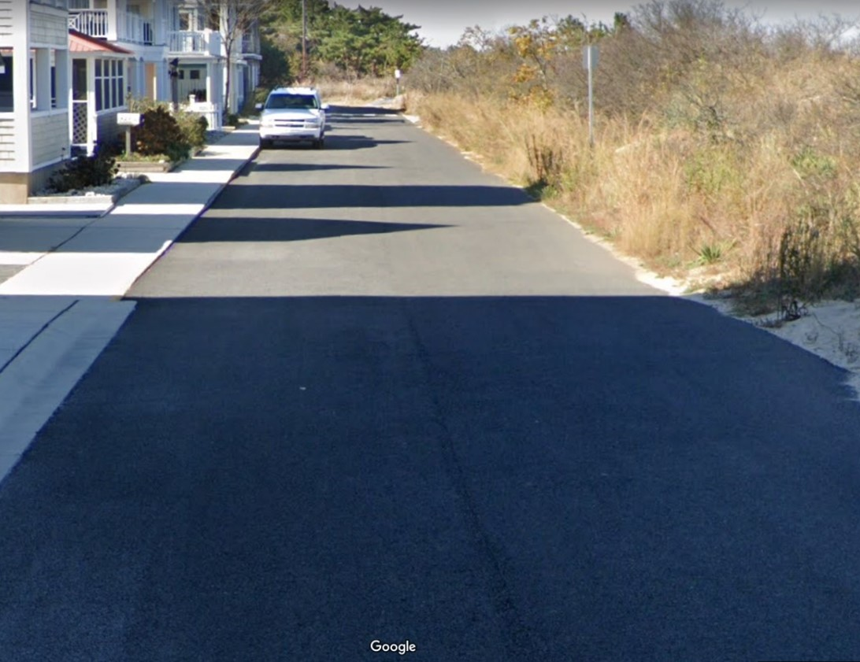
Porous Asphalt
-Engineered porous asphalt with stone subbase
-Infiltrates stormwater to subsurface
-Infiltrates anything dumped on it as well
-Pervious design
-Looks like regular asphalt
-Highly porous over time
-

Slide 24
Walkway? Surface Material? Location?
A lot of comments were made about the lack of a sidewalk or pedestrian safety area around the public slip area. There is a lot of traffic (both vehicular and foot) around West Harbor due to the Inn and area residents
There is enough room between the top of bulkhead and West Harbor Road to include a 5’ walking path.
Location? Right at back of bulkhead?
Finish material? Wooden walkway or porous concrete?

Slide 25
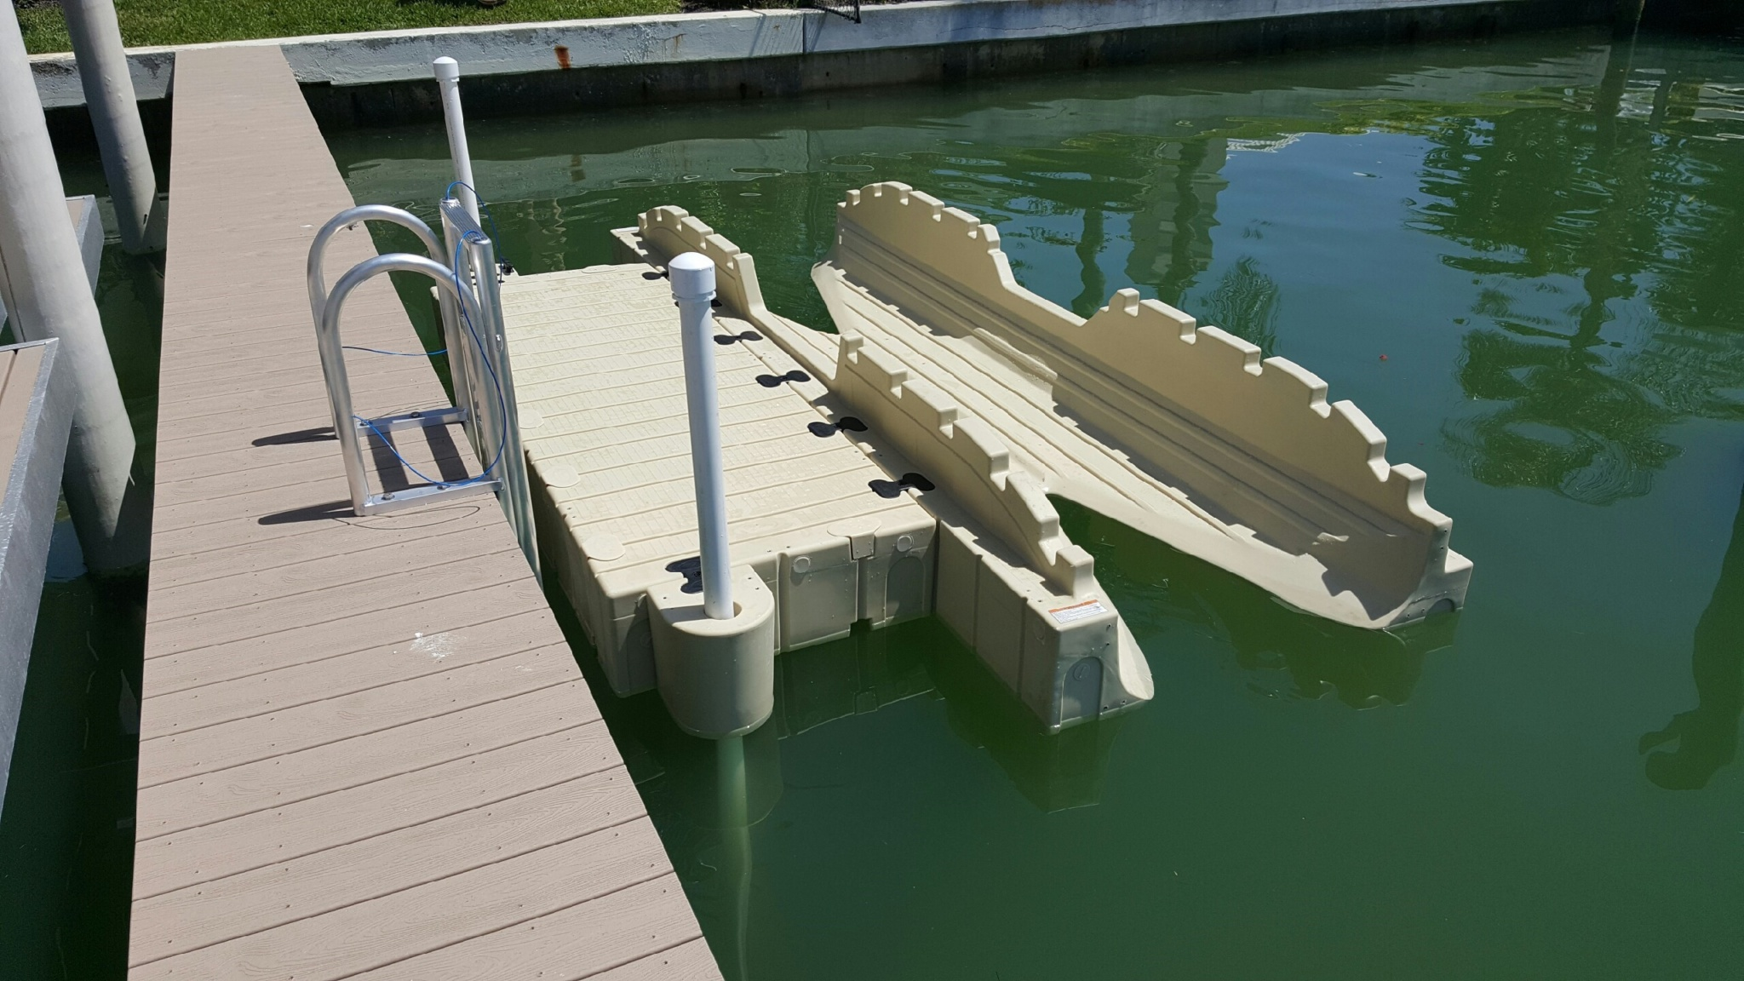
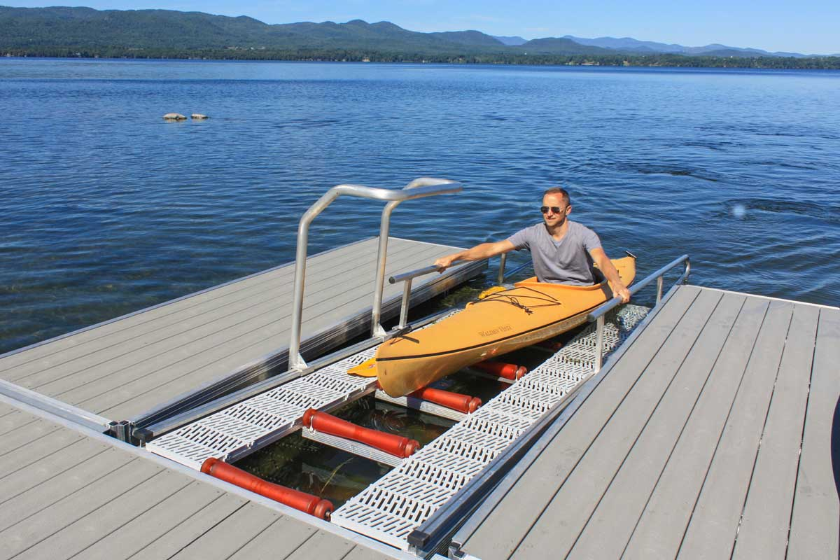
Kayak Launch Options

Slide 26
Utility (water and electric) Pedestals for Watermen Slip Area, with Light built in

Slide 27
WaPro Backflow preventer Used by: Ocean City, MD St. Augustine, FL Norfolk, VA

Slide 28
Wapro Flow Regulator Potential for use at upper drainage area (High School) to regulate flow to the Public Slip area. Constant flow and utilizes storage upstream.

Slide 29
Questions
Brent Jett, P.E., CFM, CC-P
bjett@gmbnet.com

