Slide 1
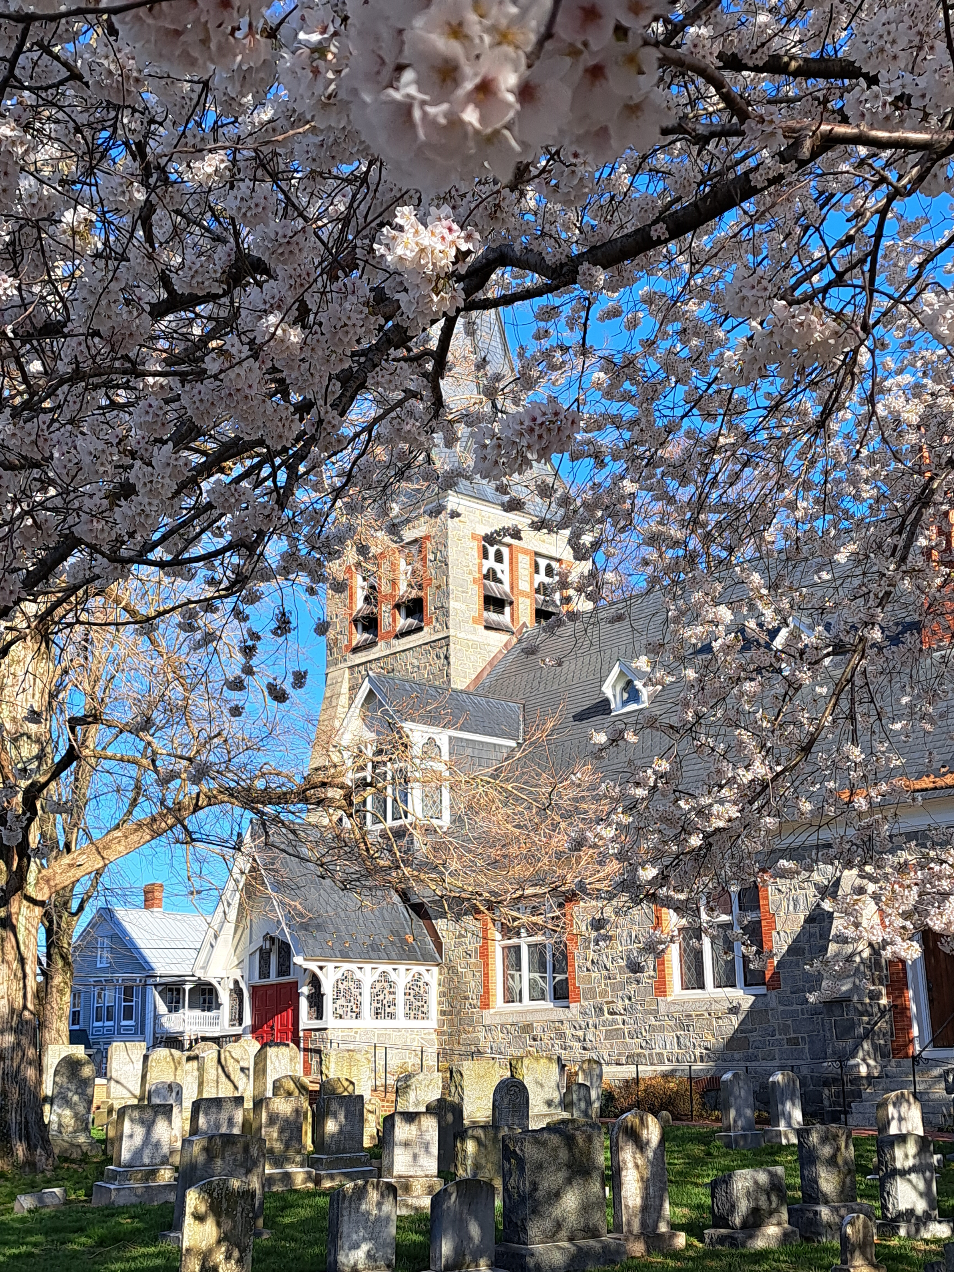
St. Michaels Land use assessment, 2024
Potential Development – residential & commercial uses
Future annexation areas & areas of mutual concern with county
“big ideas” for the plan
Comprehensive plan update – tentative schedule, public outreach

Slide 2
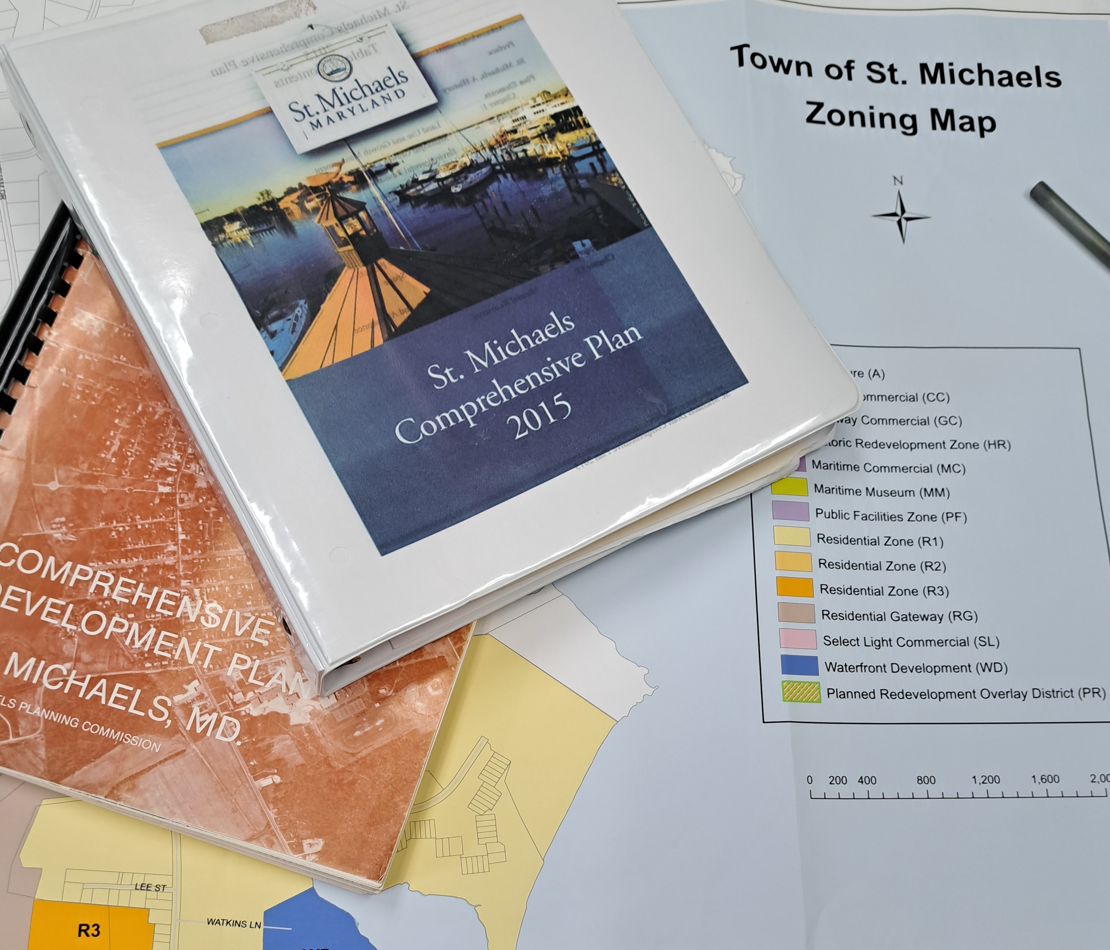
Update the comprehensive plan 2024-2025
utilize this sustainable communities report to help guide the
comprehensive plan update. An update is required by the state of
Maryland by the end of 2025

Slide 4
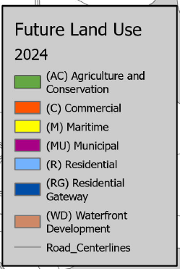
St. Michaels Land Use Acreage Geographic information system (GIS) Talbot County Public Works, GIS future land use – base map information
Agriculture = 144.73 acres
Commercial = 41.55
Maritime = 25.00 acres
Municipal = 29.96 acres
Residential = 396.04 acres
Residential Gateway = 125.77 acres
Waterfront Development = 16.03 acres

Slide 5
Development potential
St. Michaels is mostly developed or “built out”
What Remains for growth (if anywhere?)
Are there potential annexation areas?
What about areas of Mutual Concern with Talbot County?

Slide 6
Potential Residential Development (inventory, Feb. 2024)
Type: Yearly Potential (10 year) Build Out
Infill, 2nd floor apartments & accessory units estimated 2/year 20
Residential Vacant Lots - 20-25 remaining (2024) 2/year 24
Dodson Residential Site (1.7 acres, 6-8 lots) 0/year 8
Residential Gateway (north town site, 27 acres) 0/year 27
Strausburg Site (well and septic), approved for 10 lots 0/year 10
TOTAL 4/year 89

Slide 7
Potential commercial/office development Inventory, Feb.2024
Potential Build Out (10 years)
Gateway Commercial (#1) 1.8 acres @10,000 s.f./acre = 18,000 s.f.
Gateway Commercial/Mixed Use (#2) 3 acres, 1 acre commercial = 10,000 s.f.
Fremont Street (3 Sites) 17,257 s.f. @ 25% development = 4,315 s.f.
Potential Conversion of Houses in Commercial Zones
(estimated conversion of 4 houses @ 2,500 s.f. over next 10 years ) = 10,000 s.f.
TOTAL = 42,315 s.f

Slide 8
Annexation Regulations
Annexation Petition: Area must be contiguous and not create an enclave
Requires: 25% of qualified voters in the area and 25% of the property owners to agree
Purpose: extension of public facilities, expand tax base, local control, developer improvements, economic development, unify boundary area, achieve growth goals
Possibility for phasing tax changes as incentive?

Slide 11
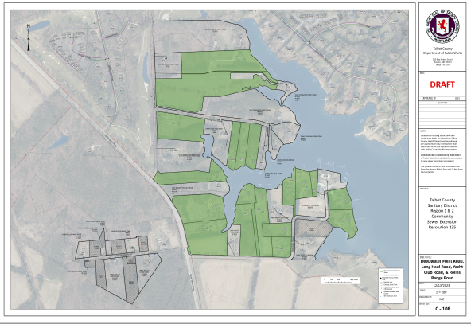

Slide 14
Sustainable communities plan (SOME PRIORITIES)
Community Health & Quality of Life
New Plan for SDC Park
Promote arts organizations
Support new Community Center
Local Planning & Staffing Issues
Analyze Short Term Rentals
Utilize SC Report for Comprehensive Plan update
Consider staff assistance
Environment:
Complete CC/SLR Studies
Improvements to water systems
Complete the Nature Trail
Economy:
Fiber optic improvements
Relocate utility poles
Cost/benefits of festivals
Transportation:
Greater crosswalk controls
Study parking, street designs, signage, circulation
School access improvement plan

Slide 15
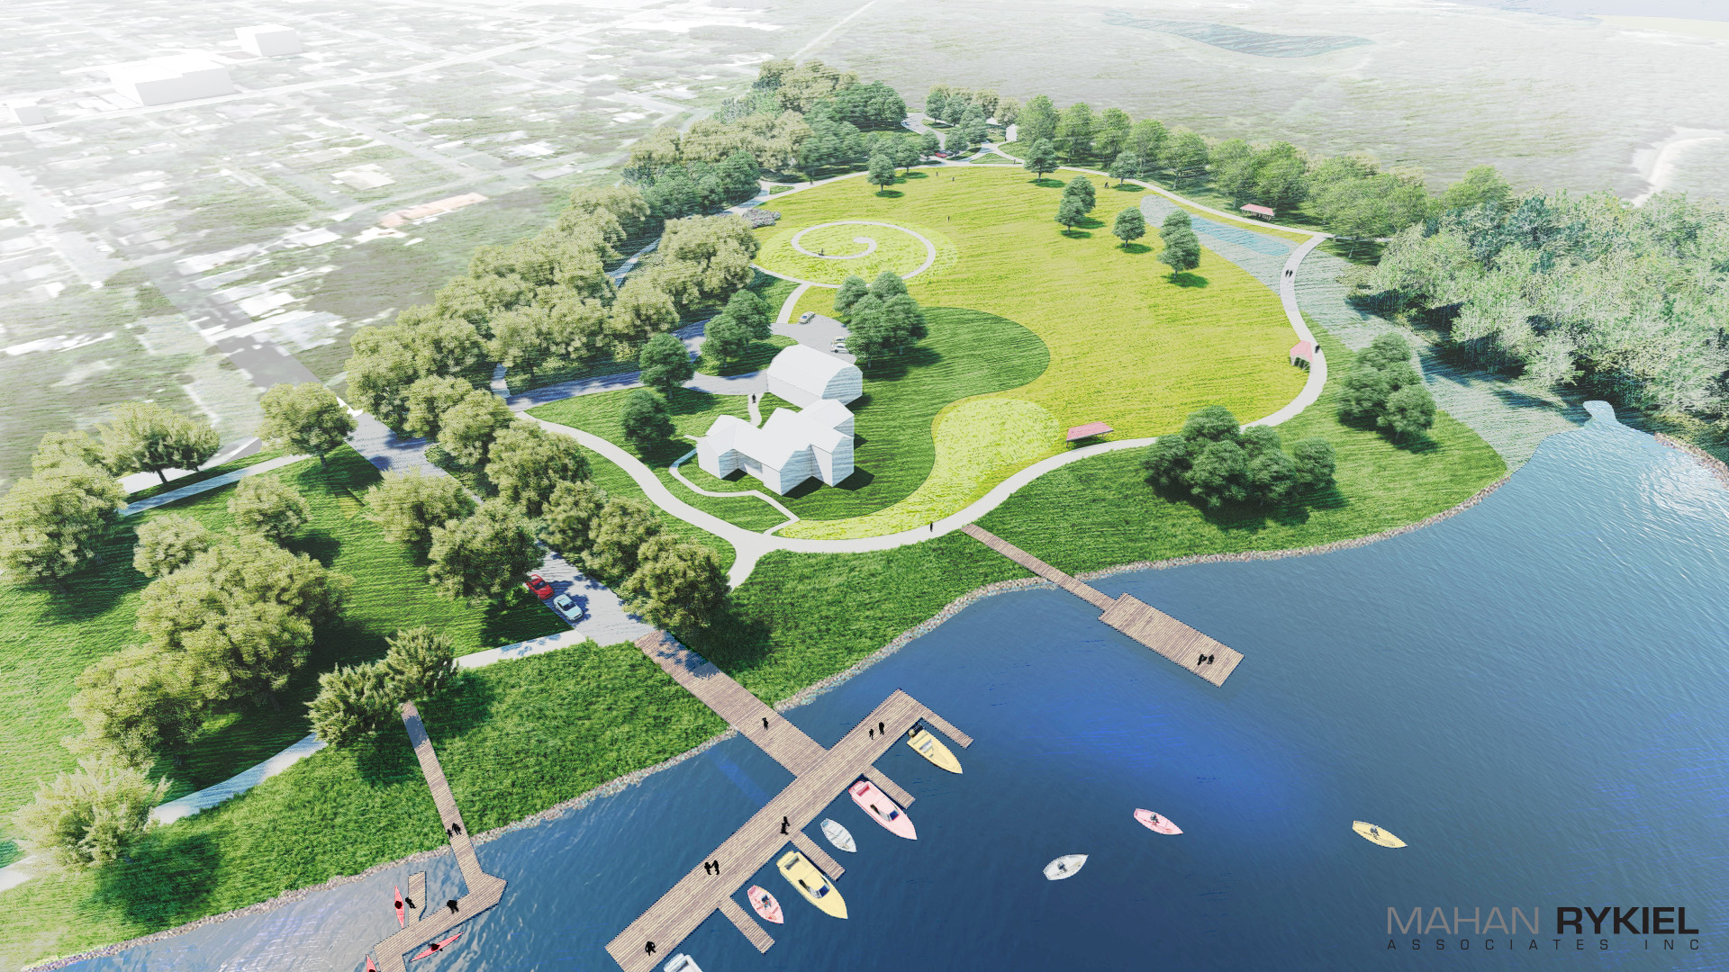
“The Big Ideas” 1. San Domingo Creek Park

Slide 16
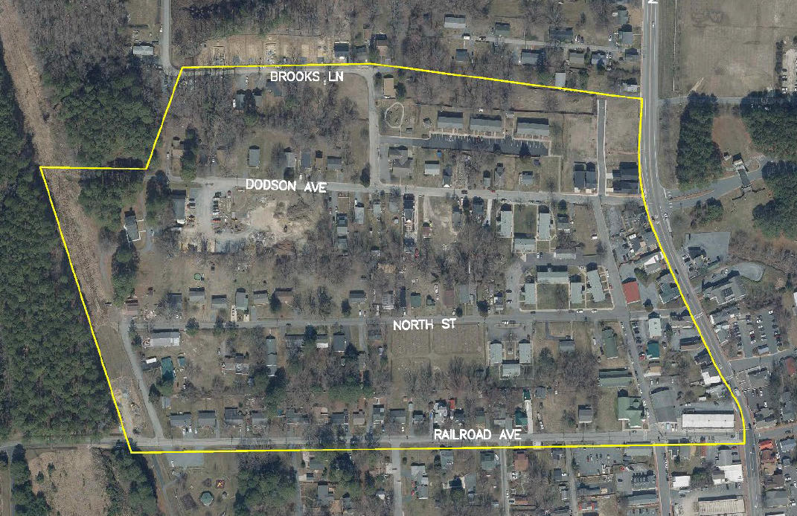
“The Big Ideas” 2. flood & sea level rise mitigation

Slide 17
“The big ideas” 3. Nature trail extension

Slide 18
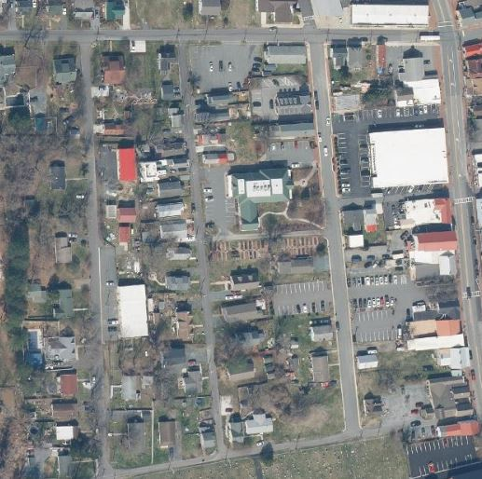
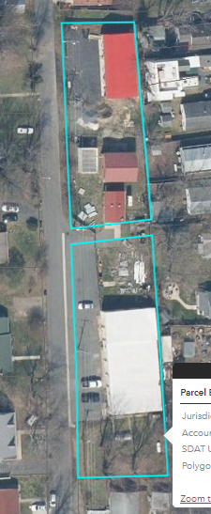
“The big ideas” 4. Redevelopment & Design study – FREMONT ST. AREA Public works area

Slide 20
What’s Next?
- Start review and discussion of chapters
Chapters 1 & 2 April, Chapters 3 & 4 May
- Schedule and hold initial public outreach meeting (June)
- Discuss issues of concern & process
- Changes, requests – consensus
Contact:
Steve Ball, Town Planner
Sball@stmichaelsmd.gov
410-745-9535

